Slide 1
Comp 2000, Data Structures Application 4: List Card Game: UNO
Group 13: Ethan Arrowood – Card Class, Presentation Jackson Schwarz – Game Class, Application Design James Coyne – Player Class, Application Design Kevin Humphreys – Pile Class & subclasses, App Design

Slide 2
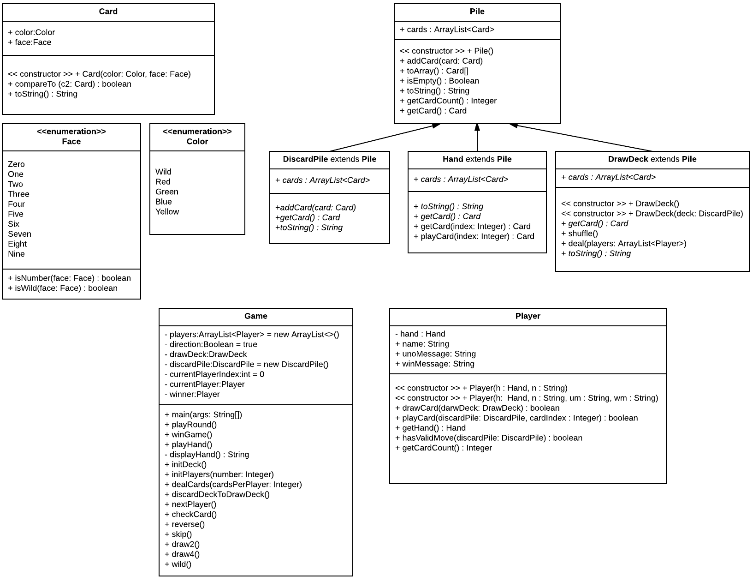
Application
Simulate UNO game
Utilize Pile ADT for aspects such as the deck, Player’s hands, and the discard pile.
The game uses a series of methods and logical methods to execute basic game functions such as skip, draw4, and wild.
Card class uses enumerable data types in order to control the valid types of cards

Slide 3
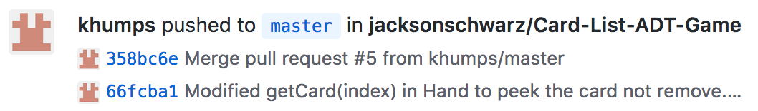
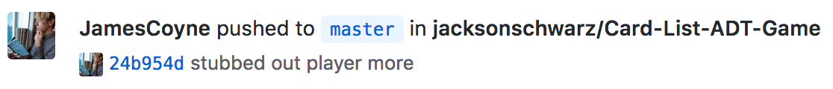
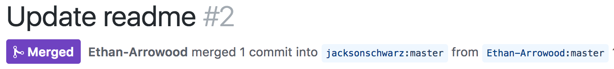
Issues and Solutions
Who knows how to use Git properly?

Slide 4

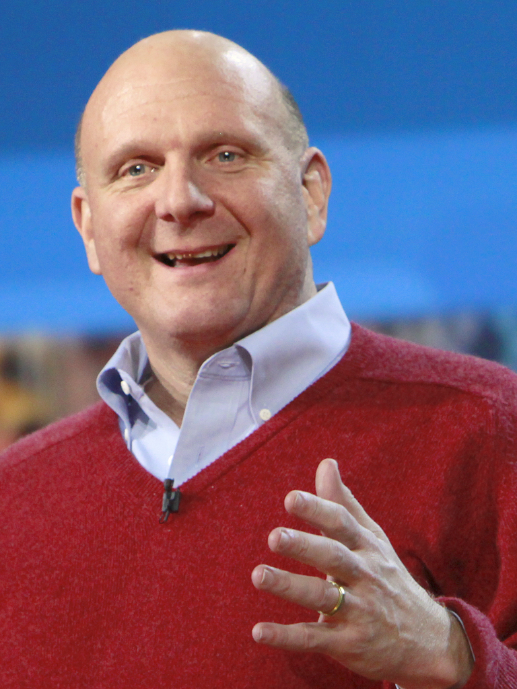

Issues and Solutions
What do these three people have in common?

Slide 5
Issues and Solutions
What do these three people have in common?
Aside from that entirely truthful story, none of them were in Boston for a good portion of time and delayed the development of the lab assignment.

Slide 6
Take-aways
Git is awesome when used correctly
Great UML designs helps a lot with application design
Working through an example game helps with application design

